Slide 1

Scaling Smart:
Revenue and
Performance
Analysis
Maddalena Niedda

Slide 2
Objective: Produce insights to support strategic growth and revenue improvements
TASKS:
1) Calculate revenue by treatment/doctor
2) segment high-value patients
3) simulate pricing changes
4) track changes over time
5) flag and update anomalies
Deliver: SQL scripts with comments, revenue summary, one-slide business insight pitch

Slide 3

OVERALL REVENUE PERFORMANCE
--Total revenue and average spent by patient
SELECT
ROUND(SUM(amount),2) AS total_revenue, ROUND(AVG(amount),2) AS avg_revenue_patient
FROM billing
WHERE payment_status= "Paid";
KEY PERFORMANCE INDICATORS. Based on Paid bills
KEY METRICS | Value
Total Revenue | £173,425
Average Revenue per Patient | £2,709
Total Patients_id | 64
Average Revenue per Doctor | £17,342
--Average Revenue per Doctor
SELECT
ROUND(SUM(b.amount)/ COUNT(DISTINCT d.doctor_id),0) AS avg_revenue
FROM billing b
JOIN treatments t ON b.treatment_id = t.treatment_id
JOIN appointments a ON t.appointment_id = a.appointment_id
JOIN doctors d ON a.doctor_id = d.doctor_id
WHERE payment_status= "Paid";
Treatment Type | Patient_id Count | Revenue | Avg revenue/patient | % of Total
X-Ray | 17 | £47,979 | £2,822 | 27.67
MRI | 14 | £43,064 | £3,076 | 24.83
Chemotherapy | 13 | £32,607 | £2,508 | 18.8
Physiotherapy | 11 | £32,251 | £2,932 | 18.6
ECG | 9 | £17,523 | £1,947 | 10.1

Slide 4

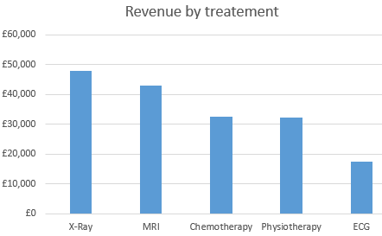
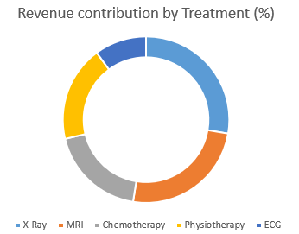
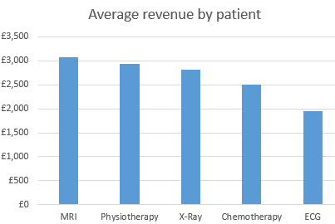
SELECT
t.treatment_type, COUNT(b.patient_id) AS patient_count, ROUND(SUM(b.amount),0) AS total_revenue,
ROUND(SUM(b.amount)/ COUNT(b.patient_id),1) AS avg_revenue_per_patient,
ROUND(SUM(b.amount) / (SELECT SUM(b.amount) FROM billing b WHERE payment_status = 'Paid') * 100, 2) AS percentage_of_total
FROM billing b
JOIN treatments t ON b.treatment_id = t.treatment_id
JOIN appointments a ON t.appointment_id = a.appointment_id
WHERE payment_status= "Paid"
GROUP BY treatment_type
ORDER BY total_revenue DESC;
1. Revenue by Treatment Type
Top Performing Treatment (by revenue)
Treatment Type | Patient_id Count | Revenue | Avg revenue/patient | % of Total
X-Ray | 17 | £47,979 | £2,822 | 27.67
MRI | 14 | £43,064 | £3,076 | 24.83
Chemotherapy | 13 | £32,607 | £2,508 | 18.8
Physiotherapy | 11 | £32,251 | £2,932 | 18.6
ECG | 9 | £17,523 | £1,947 | 10.1
Performance Insights:
X-Ray drives 28% of the revenue → top revenue generator
X-Ray and MRI account for over half of revenue → highest value services
MRI leads in top per-patient revenue → most profitable treatment, investment opportunity

Slide 5
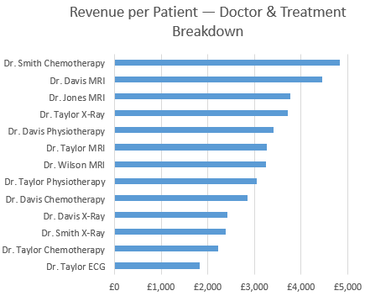
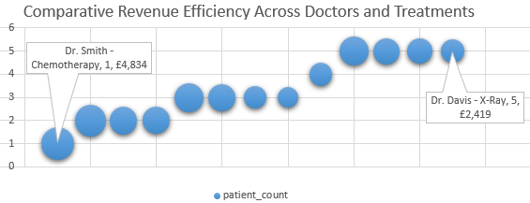
1. 2 Revenue by Doctor/Treatment
--Revenue by Doctor and treatment, patient count, revenue by patient
SELECT
CONCAT("Dr. ",d.last_name) AS Doctor,
t.treatment_type AS treatment,
ROUND(SUM(b.amount),0) AS total_revenue,
COUNT(DISTINCT b.patient_id) AS petient_count,
ROUND(SUM(b.amount) / COUNT(DISTINCT b.patient_id),1)
AS revenue_by_Patient
FROM billing b
JOIN treatments t ON b.treatment_id = t.treatment_id
JOIN appointments a ON t.appointment_id = a.appointment_id
JOIN doctors d ON a.doctor_id = d.doctor_id
WHERE payment_status= "Paid"
GROUP BY d.last_name, treatment
ORDER BY total_revenue DESC;
Revenue-Generating Doctor/Treatment Analysis
Doctor | treatment_ type | total_ revenue | patient_ count | Revenue_by _Patient
Dr. Taylor | X-Ray | £18,538 | 5 | £3,708
Dr. Taylor | Physiotherapy | £15,199 | 5 | £3,040
Dr. Davis | Chemotherapy | £14,220 | 5 | £2,844
Dr. Davis | X-Ray | £12,096 | 5 | £2,419
Dr. Jones | MRI | £11,279 | 3 | £3,760
Dr. Wilson | MRI | £9,760 | 3 | £3,253
Dr. Smith | X-Ray | £9,515 | 4 | £2,379
Dr. Davis | MRI | £8,891 | 2 | £4,446
Dr. Davis | Physiotherapy | £6,808 | 2 | £3,404
Dr. Taylor | Chemotherapy | £6,674 | 3 | £2,225
Dr. Taylor | MRI | £6,535 | 2 | £3,268
Dr. Taylor | ECG | £5,463 | 3 | £1,821
Dr. Smith | Chemotherapy | £4,834 | 1 | £4,834
Performance Insights:
Dr. Smith (Chemo) has the highest revenue per patient → Best practices candidate
Dr. Davis (X Ray) sees most patients, but lower per-patient revenue → Opportunity for premium service offerings

Slide 6
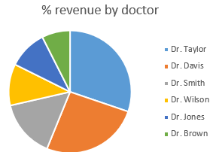
1. 3 Revenue by Doctor (All treatments combined)
--Revenue by Doctor, Doc % revenue
SELECT
CONCAT("Dr. ",d.last_name) AS Doctor,
ROUND(SUM(b.amount),0) AS total_revenue,
ROUND(SUM(b.amount) / (SELECT SUM(b.amount) FROM billing b
WHERE payment_status = 'Paid') * 100, 2) AS percentage_of_total
FROM billing b
JOIN treatments t ON b.treatment_id = t.treatment_id
JOIN appointments a ON t.appointment_id = a.appointment_id
JOIN doctors d ON a.doctor_id = d.doctor_id
WHERE payment_status= "Paid"
GROUP BY d.last_name
ORDER BY total_revenue DESC;
Rank | Doctor | total_revenue | %
1 | Dr. Taylor | 52410 | 30.22
2 | Dr. Davis | 44975 | 25.93
3 | Dr. Smith | 26491 | 15.28
4 | Dr. Wilson | 18936 | 10.92
5 | Dr. Jones | 17693 | 10.2
6 | Dr. Brown | 12920 | 7.45
Performance Insights:
Top 2 doctors (Taylor, Davis) generate 56% of total revenue → Retention critical

Slide 7

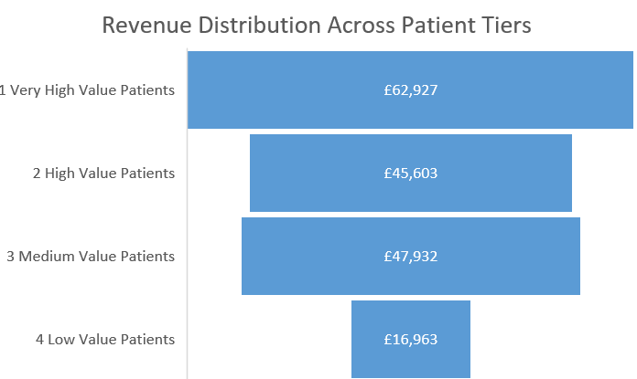
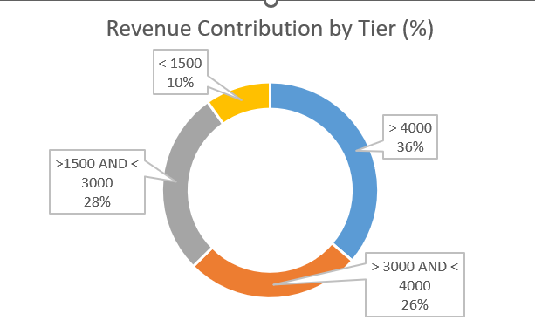
2. Segment high-value patients
----CASE --Segment High-Value Patients
SELECT
CASE
WHEN amount < 1500 THEN "4 Low Value Patients"
WHEN amount BETWEEN 1500 AND 3000 THEN "3 Medium Value Patients"
WHEN amount BETWEEN 3000 AND 4000 THEN "2 High Value Patients"
ELSE "1 Very High Value Patients"
END AS value_amount_petients,
COUNT (*) AS patient_count,
SUM(amount) AS total_revenue,
ROUND(SUM(amount) / (SELECT SUM(amount) FROM billing
WHERE payment_status = 'Paid') * 100, 2) AS percentage_of_revenue
FROM patients p
JOIN billing b
ON p.patient_id=b.patient_id
WHERE payment_status="Paid"
GROUP BY value_amount_petients
ORDER BY value_amount_petients;
High Value patient segmentation
Tier | Criteria | patient_count | total_revenue | % of total revenue
1 Very High Value Patients | > 4000 | 14 | £62,927 | 36.29
2 High Value Patients | > 3000 AND < 4000 | 13 | £45,603 | 26.3
3 Medium Value Patients | >1500 AND < 3000 | 21 | £47,932 | 27.64
4 Low Value Patients | < 1500 | 16 | £16,963 | 9.78
Performance Insights:
The top two tiers (27 patients) are responsible for nearly two-thirds of the total income → 80/20 rule

Slide 8

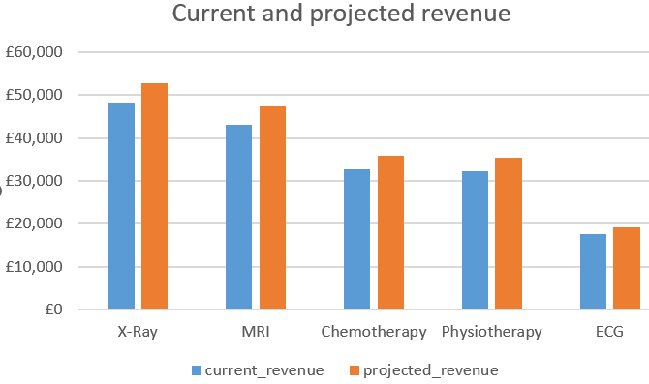
3. Simulate pricing changes
-- +10% price increase SELECT
SELECT
t.treatment_type, ROUND(SUM (amount),0) AS current_revenue,
ROUND(SUM(b.amount * 1.10),0) AS projected_revenue
FROM billing b
JOIN treatments t ON b.treatment_id = t.treatment_id
WHERE payment_status= "Paid"
GROUP BY t.treatment_type
ORDER BY projected_revenue DESC;
Revenue 10% increase
treatment_type | current_revenue | projected_revenue
X-Ray | £47,979 | £52,777
MRI | £43,064 | £47,371
Chemotherapy | £32,607 | £35,868
Physiotherapy | £32,251 | £35,477
ECG | £17,523 | £19,275
Performance Insights:
Projection of prices increased by 10%

Slide 9

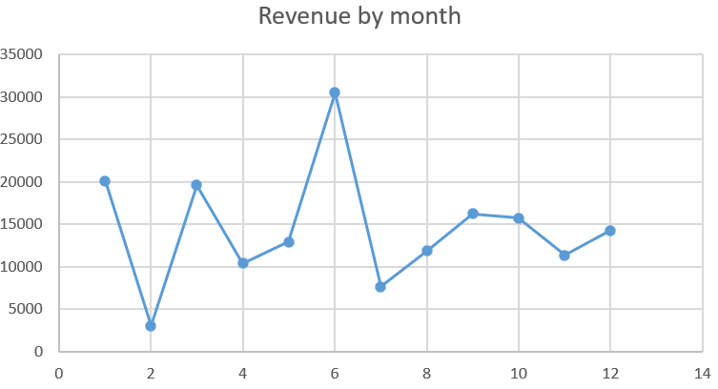
4. Track changes over time
--revenue by month
SELECT
EXTRACT(MONTH FROM b.bill_date) AS month,
EXTRACT(YEAR FROM b.bill_date) AS year,
ROUND(sum(b.amount),2) AS montly_amount
FROM billing b
WHERE payment_status= "Paid"
GROUP BY year , month
ORDER BY month;
Revenue trend over time
month | year | Revenue
1 | 2023 | £20,081
2 | 2023 | £3,033
3 | 2023 | £19,596
4 | 2023 | £10,380
5 | 2023 | £12,892
6 | 2023 | £30,474
7 | 2023 | £7,638
8 | 2023 | £11,838
9 | 2023 | £16,204
10 | 2023 | £15,709
11 | 2023 | £11,308
12 | 2023 | £14,273
Performance Insights:
Revenue fluctuates significantly throughout the year (irregular monthly performance) → diversify revenue stream
Lowest Month: February—possible seasonal or operational factor → analyse root cause
Peak Month: June— highest-performing month, almost 2× the yearly average → maximise high-season revenue

Slide 10

5. Flag and update anomalies
--min, max amount
SELECT max(amount), min(amount)
FROM billing;
--Flag and Update Anomalies, search for (amount > 4900 OR amount < 700)
SELECT *
FROM billing
WHERE payment_status= "Paid"
AND (amount > 4900 OR amount < 700)
ORDER BY amount DESC;
bill_id | patient_id | treatment_id | bill_date | amount | payment_method | payment_status
B108 | P024 | T108 | 45037 | £4,974 | Cash | Paid
B142 | P019 | T142 | 45231 | £663 | Insurance | Paid
B188 | P002 | T188 | 45028 | £616 | Cash | Paid
Process/ Insights:
Data with exceptionally low or high amounts were extracted for anomaly analysis. The review found no irregularities.

Slide 11
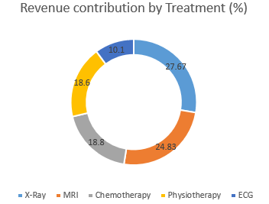
Revenue and Performance Insight
KEY METRICS | Value
Total Revenue | £173,425
Average Revenue per Patient | £2,709
Total Patients_id | 64
Average Revenue per Doctor | £17,342
Segment high-value patients
The top two tiers (27 patients) are responsible for nearly two-thirds of the total income → 80/20 rule
Revenue by Treatment Type
X-Ray drives 28% of the revenue → top revenue generator
X-Ray and MRI account for over half of revenue → highest value services
MRI leads in top per-patient revenue → most profitable treatment, investment opportunity
Simulate pricing changes
Visual projection of prices increased by 10%
Track changes over time
Revenue fluctuates significantly throughout the year (irregular monthly performance) → diversify revenue stream
Lowest Month: February—possible seasonal or operational factor → analyse root cause
Peak Month: June— highest-performing month, almost 2× the yearly average → maximise high-season revenue
Revenue by Doctor/Treatment
Dr. Smith (Chemo) has the highest revenue per patient → Best practices candidate
Dr. Davis (X Ray) sees most patients, but lower per-patient revenue → Opportunity for premium service offerings

